Slide 1
COMP 3355 Cyber Security
Assignment 1 Tutorial
Crida Wei

Slide 2
List of tools (java programs) provided

Slide 3
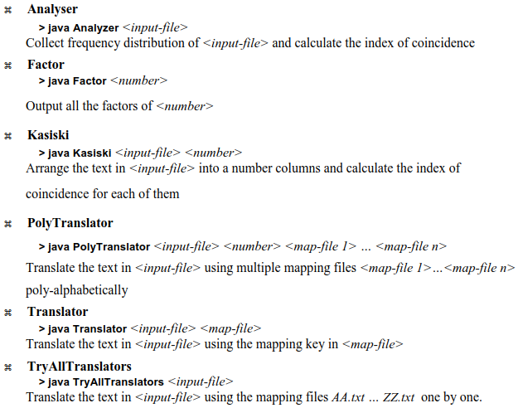
List of tools (java programs) provided

Slide 4
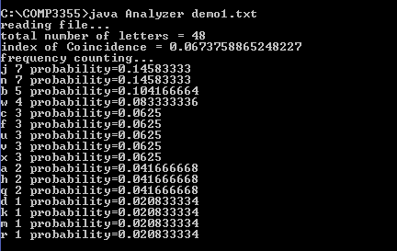
Monoalphabetic Ciphers Cryptanalysis - Example
1. Given the following cipher text input (demo1.txt):
fqjcb rwjwj vnjax bnkhj whxcq nawjv nfxdu mbvnu ujbbf nnc
2. Analyze the cipher text by collecting frequency distribution, index of coincidence by running the Java program: Analyzer.java > java Analyzer demo1.txt
You should see the following results:

Slide 5
3. Prepare mapping file that describes substitutions between cipher text alphabets and plain text alphabets. The format of the file is in the form of C=P where C is a cipher text alphabet and P is a plain text alphabet. In the given example, if we make a wild guess that cipher text j maps to plain text e, we can then try to see if any regular arrangement happen in the mapping, such as 10 (j) →5 (e), 9 (i) → 4 (d), 11 (k) → 6(f), …, etc. That is c = (p+5) mod 26. Then, we can prepare a text file map_demo1.txt to include some mappings (e.g. popular letters and vowels letters) for trial guess, such as:
f=a g=b h=c i=d j=e k=f l=g m=h n=i

Slide 6
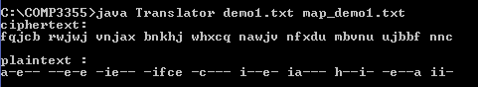
4. Now, we can perform trial decryption based on the cipher text file demo1.txt and mapping file map-demo1.txt by using the given Java program: Translator.java
> java Translator demo1.txt map_demo1.txt

Slide 7
Demonstration of Caesar ciphers cryptanalysis
We encode 26 Caesar ciphers into 26 different mapping files. They are named as AA.txt, BB.txt, …, ZZ.txt. For example, the mapping file AA.txt encodes the Caesar cipher c = (p+0) mod 26 while the mapping file BB.txt encodes the Caesar cipher c = (p+1) mod 26, etc.
We can use the program TryAllTranslator to try all 26 Caesar ciphers. The first command line parameter denotes the cipher text while the second parameter denotes the path where to locate the 26 mapping files (it is ‘.’ for current directory). The following figure shows several trials run of the program.
> java TryAllTranslator demo1.txt .

Slide 8
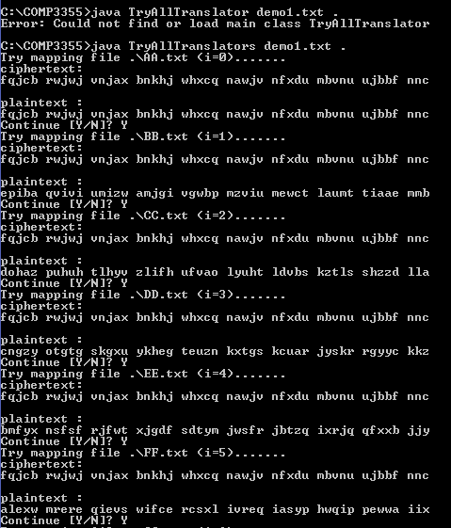
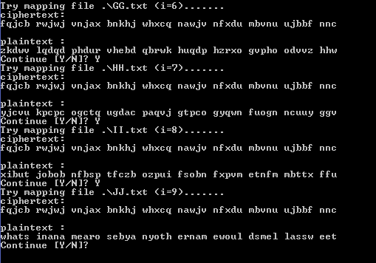
Recovered
Plaintext!

Slide 9
Polyalphabetic Ciphers Cryptanalysis - Example
1. Given the following cipher text input (demo2.txt):
ZHYME ZVELK OJUBW CEYIN CUSML RAVSR YARNH CEARI UJPGP VARDU QZCGR NNCAW JALUH GJPJR YGEGQ FULUS QFFPV EYEDQ GOLKA LVOSJ TFRTR YEJZS RVNCI HYJNM ZDCRO DKHCR MMLNR FFLFN QGOLK ALVOS JWMIK QKUBP SAYOJ RRQYI NRNYC YQZSY EDNCA LEILX RCHUG IEBKO YTHGV VCKHC JEQGO LKALV OSJED WEAKS GJHYC LLFTY IGSVT FVPMZ NRZOL CYUZS FKOQR YRYAR ZFGKI QKRSV IRCEY USKVT MKHCR MYQIL XRCRL GQARZ OLKHY KSNFN RRNCZ TWUOC JNMKC MDEZP IRJEJ W

Slide 10
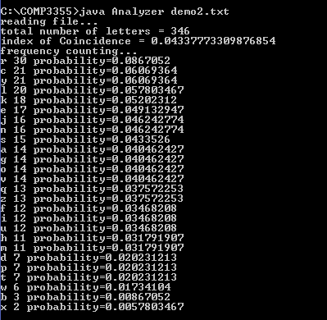
2. Analyze the cipher text by collecting frequency distribution, index of coincidence by running the Java program: Analyzer.java
> java Analyzer demo2.txt You should see the following results:

Slide 11
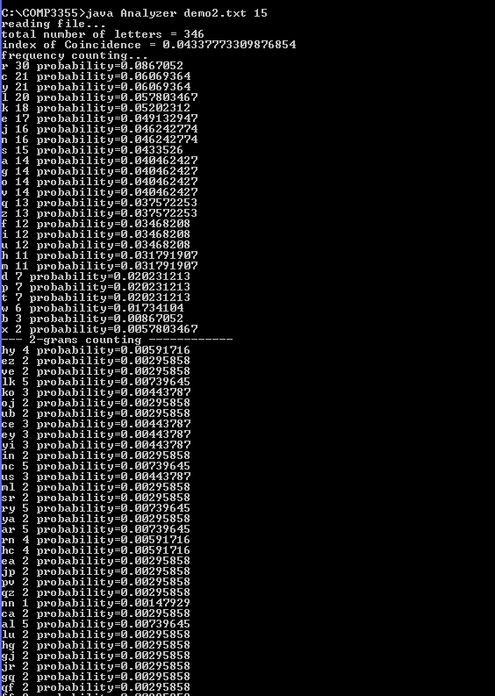
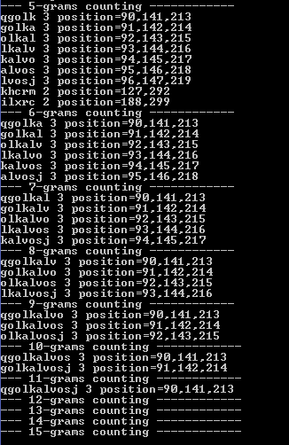
3. The index of coincidence is 0.043 and far less than 0.068. It indicates that the cipher text is probably encrypted by using a polyalphabetic cipher. Therefore, we need further analysis by finding any repeated patterns, their locations and their frequencies. To do these, we can use the program Analyzer to locate the consecutive N cipher text letters (N-grams) and output their distributions (for 2 consecutive letters) or their locations in the cipher text (for 3 or more consecutive letters). To get the 15-gram distributions, we run
> java Analyzer demo2.txt 15

Slide 12
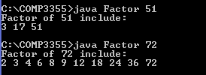
4. By looking at the longest repeated patterns and following the distances between the repeated sequences, we can determine the possible key lengths that used for the substitutions. In this example, the longest repeated pattern is qgolkalvosj of length 11 and the distance between the first 2 sequences is 141-90 = 51, while the distance between the second 2 sequences is 213 – 141 = 72. Their factors can be easily figured out by running program Factor:
> java Factor 51 > java Factor 72

Slide 13
5. Since the common divisor between 51 and 72 is 3, we are check if the ciphertext is encrypted with 3 monoalphabetic ciphers individually by calculating their index of coincidence individually. To do this, we can use the program Kasiski:
> java Kasiski demo2.txt 3

Slide 14
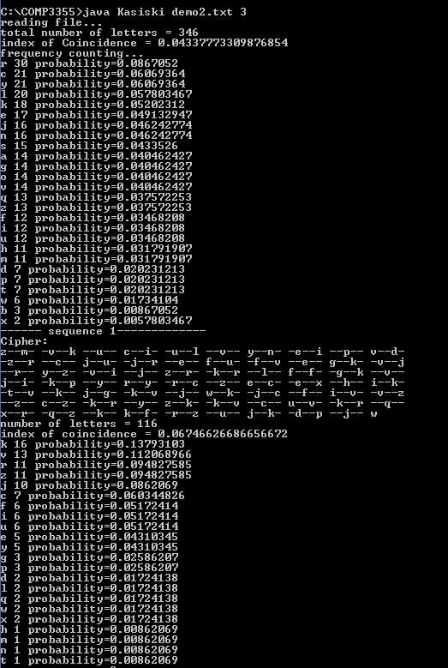
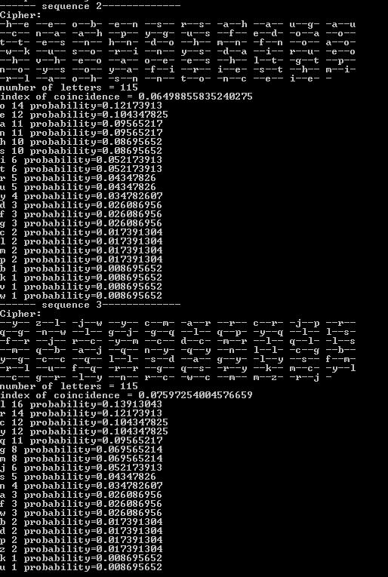

Slide 15
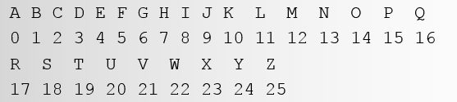
6. By observing the index of coincidence (IC), all sequences have IC close to or greater than 0.068. We are pretty sure that the cipher text is encrypted by polyalphabetic cipher. We can then prepare individual mapping files for each character sequence as in the case of monoalphabetic cipher cryptanalysis. In this example, we prepare 3 map files because the key length suggested by the Kasiski method is 3. Suppose we guess the first sequence is encrypted using the letter ‘R’ in Vigenere Tableau, and we still don’t know the remaining two letters. We can prepare use the mapping file RR.txt, and use empty.txt as remaining mapping files.
> java PolyTranslator demo2.txt 3 RR.txt empty.txt empty.txt

Slide 16
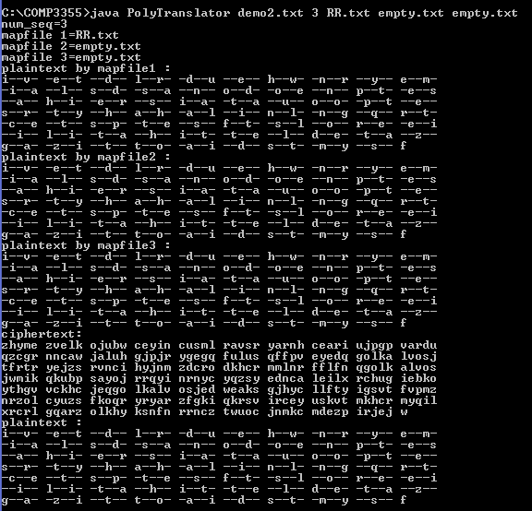

Slide 17
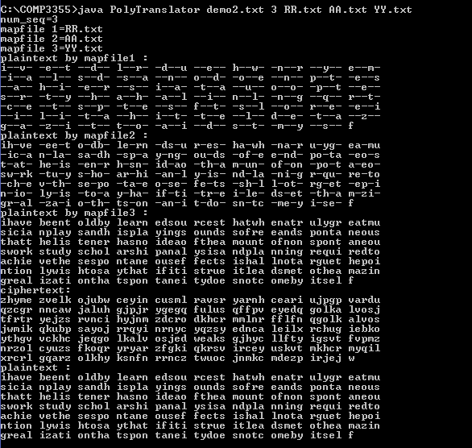

Slide 18
DES details

Slide 19

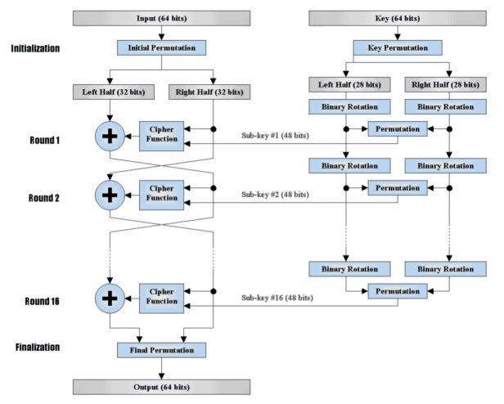
DES
DES is an implementation of a Feistel Cipher. It uses 16 round Feistel structure. The block size is 64-bit. Though, key length is 64-bit, DES has an effective key length of 56 bits, since 8 of the 64 bits of the key are not used by the encryption algorithm (function as check bits only). General Structure of DES is depicted in the following illustration

Slide 20
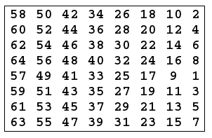
Initial Permutation
Initial Permutation takes the plaintext as input. The table consists of 64 bits numbered from 1 to 64:

Slide 21
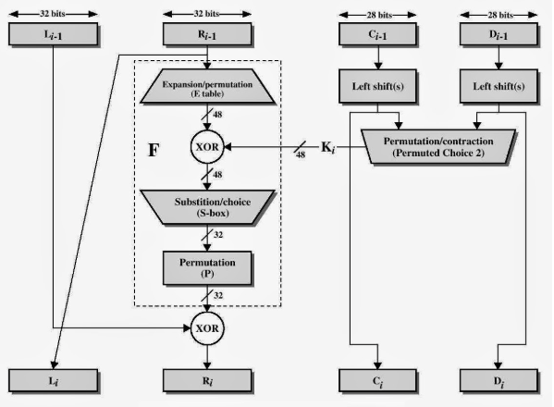
Round Function
The heart of this cipher is the DES function, f. The DES function applies a 48-bit key to the rightmost 32 bits to produce a 32-bit output.
Feistel Structure

Slide 22
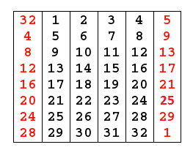
Expansion Permutation
Since right input is 32-bit and round key is a 48-bit, we first need to expand right input to 48 bits. Permutation logic is graphically depicted in the following illustration

Slide 23
XOR
− After the expansion permutation, DES does XOR operation on the expanded right section and the round key.

Slide 24
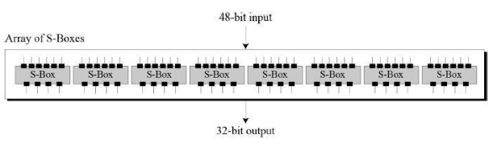
Substitution Choice (S-Box)
The S-boxes carry out the real mixing (confusion). DES uses 8 S-boxes, each with a 6-bit input and a 4-bit output. Refer the following illustration

Slide 25
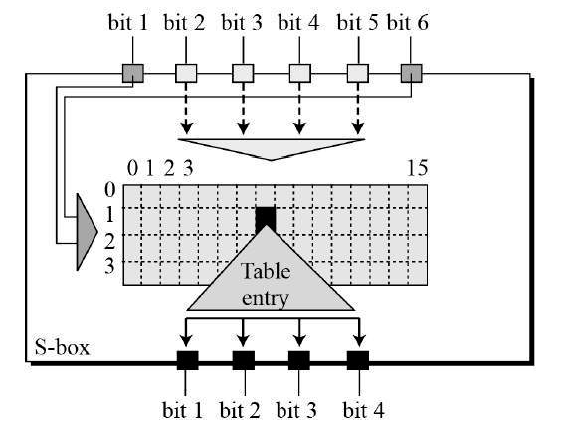
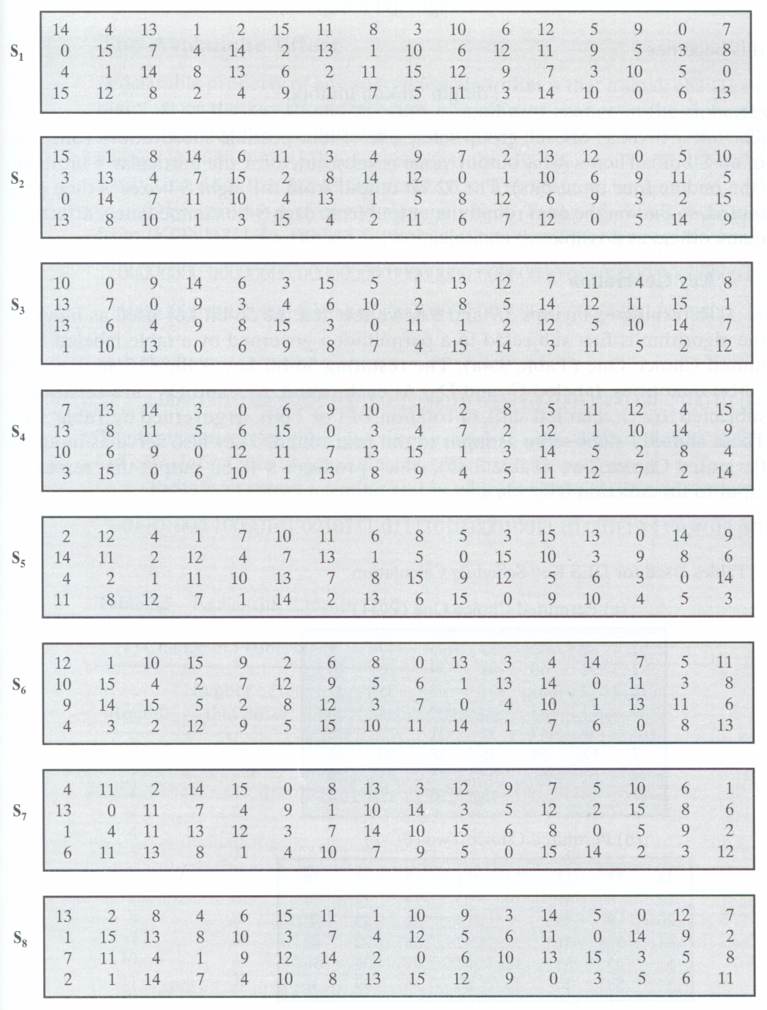

Slide 26
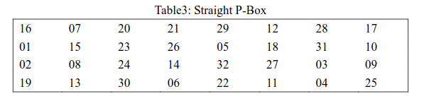
Permutation (P-Box)
The 32 bit output of S-boxes is then subjected to the straight permutation with rule shown in the following illustration:

Slide 27
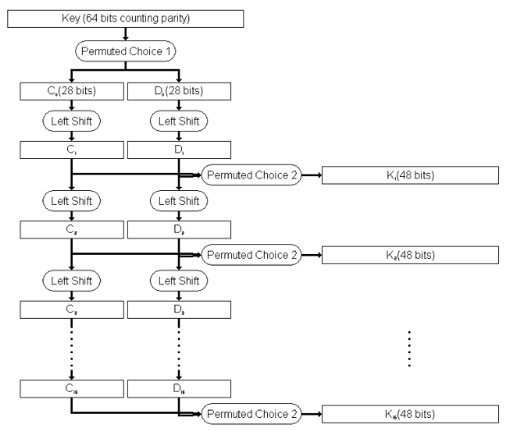
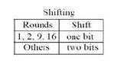
Key Generation
The round-key generator creates sixteen 48-bit keys out of a 56-bit cipher key. The process of key generation is depicted in the following illustration

Slide 28
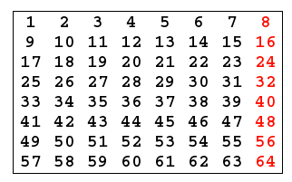
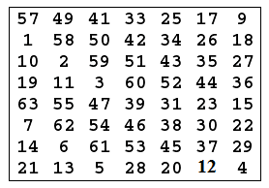
permutation Choice one (PC-1)

Slide 29
The output is separated into two 28 bits C and D. The first 28 bits are called C0 (left part) and the last 28 bits are called D0.
At each round, a circular left shift is preformed on Ci and Di by 1 or 2 bits. See the table below:

Slide 30
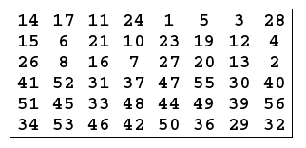
permutation choice two (PC-2)
Ignore the 9, 18, 22, 25, 35, 38, 43, 54 bit of 56bits key.
The remaining 48bits key should be permuted by the following table.
The permutation Choice Two output in each round is uses as input to the encryption algorithm.

Slide 31
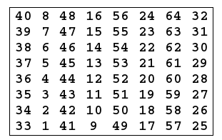
Inverse Initial Permutation

Slide 32
Reference
https://www.tutorialspoint.com/cryptography/data_encryption_standard.htm
https://www.cybrary.it/0p3n/des-data-encryption-standard/

Slide 33
Thanks!
Q&A

